Slide 1
[ Network Embedding ]
Skip-Gram
Project : Skip-Gram Implementation with Python
Seunghan Lee (CSE-URP) 20.01.17(Fri)

Slide 2
Goal
“Implement Skip-Gram Model using Random Walk”
INPUT : ( One-Hot Encoded ) Vertice
OUTPUT : Probability Distribution of Vertices
Latent Representation of input vector ( Embedded Vector )

Slide 3
Contents
1
Introduction
Brief overview of Skip-Gram & Random Walk
2
Implementation
Import Dataset & Libraries
Define Functions ( Random Walk, Softmax, Feed Forward, Back Propagation )
Skip Gram
3
Result
Visualization of Network

Slide 4
1. Introduction
Brief overview of Skip-Gram & Random Walk

Slide 5
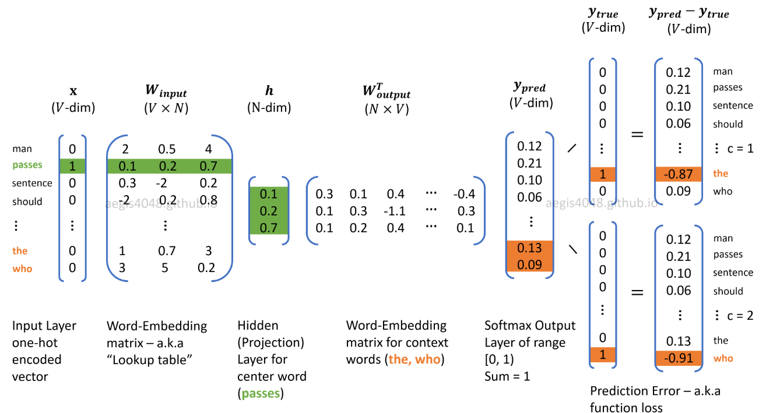
1. Introduction
1. Skip-Gram
INPUT
HIDDEN
OUTPUT
Predict Context Words given One Word
https://aegis4048.github.io/demystifying_neural_network_in_skip_gram_language_modeling

Slide 6
1. Introduction
2. Random Walk
path that consists of a succession of random steps (wikipedia)

Slide 7
1. Introduction
2. Random Walk
path that consists of a succession of random steps (wikipedia)

Slide 8
1. Introduction
2. Random Walk
path that consists of a succession of random steps (wikipedia)

Slide 9
1. Introduction
2. Random Walk
path that consists of a succession of random steps (wikipedia)

Slide 10
1. Introduction
2. Random Walk
path that consists of a succession of random steps (wikipedia)

Slide 11
1. Introduction
2. Random Walk
path that consists of a succession of random steps (wikipedia)
1. Local exploration is easy to parallelize!
2. No need for global recomputation ( enable online learning )

Slide 12
1. Introduction
2. Random Walk
path that consists of a succession of random steps (wikipedia)
1. Local exploration is easy to parallelize!
2. No need for global recomputation ( enable online learning )

Slide 13
1. Introduction
2. Random Walk
Original
34 Vertices
Ex) walk length = 9
Random Walk
10 Vertices
https://aegis4048.github.io/demystifying_neural_network_in_skip_gram_language_modeling

Slide 14
1. Introduction
2. Random Walk
Original
34 Vertices
Ex) walk length = 9
Random Walk
10 Vertices
Implement Skip Gram from these 10 vertices!
https://aegis4048.github.io/demystifying_neural_network_in_skip_gram_language_modeling

Slide 15
1. Introduction
2. Random Walk
Original
34 Vertices
Ex) walk length = 9
Random Walk
10 Vertices
Implement Skip Gram from these 10 vertices!
( window size = 2 )
https://aegis4048.github.io/demystifying_neural_network_in_skip_gram_language_modeling

Slide 16
2. Implementation
Import Dataset & Libraries
Define Functions ( Random Walk, Softmax, Feed Forward, Back Propagation )
Skip Gram

Slide 17
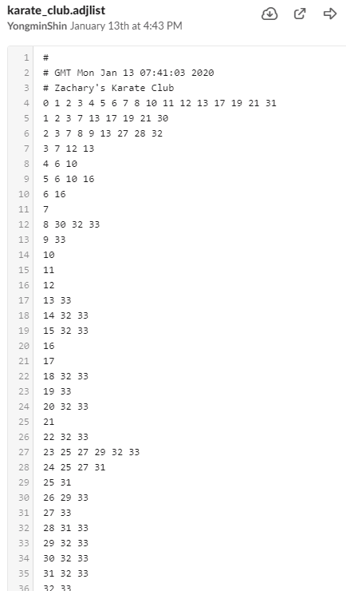
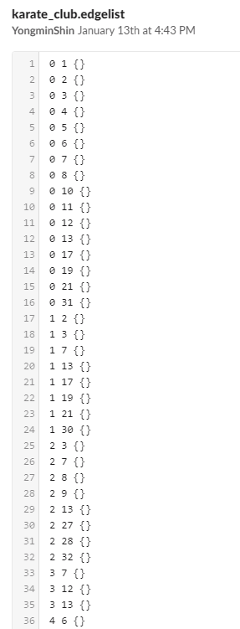
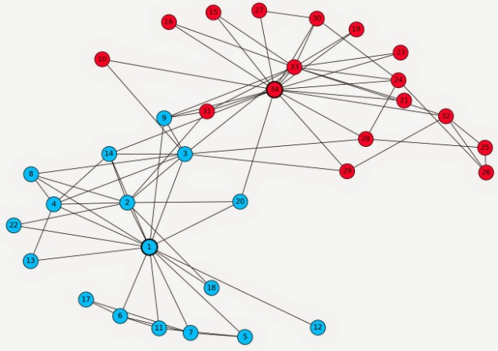
Implementation
1. Import Dataset & Libraries
[ Data Overview ]
Karate Graph
Network Graph with
34 vertices ( labeled 0 or 1 )
[ 1. adjacency list ]
[ 2. edge list ]
https://bookdown.org/omarlizardo/_main/3-1-social-network-analysis-from-relationships-to-graphs.html

Slide 18
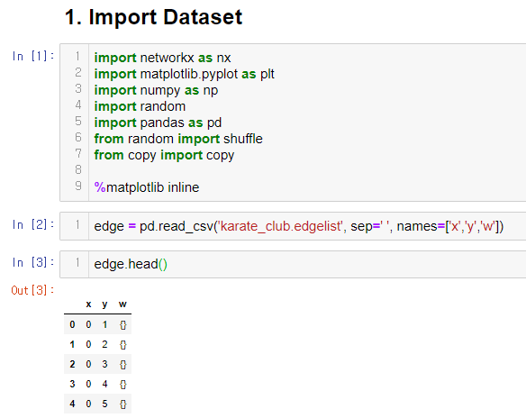
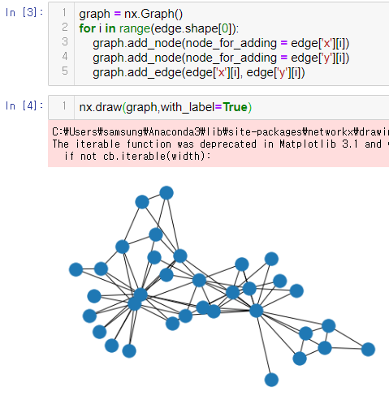
Implementation
1. Import Dataset & Libraries

Slide 19
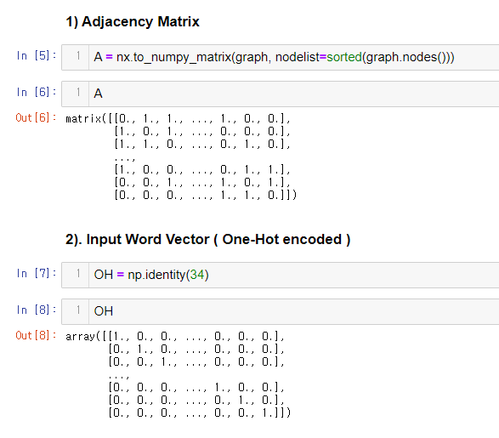
Implementation
1. Import Dataset & Libraries

Slide 20
Implementation
1. Import Dataset & Libraries
1 in adjacent vertices,
0 otherwise
Shape : 34 x 34

Slide 21
Implementation
1. Import Dataset & Libraries
for Random Walk!
- each row : one vertex - By finding the index of NON-ZERO values
1 in adjacent vertices,
0 otherwise
for Input Vector of every vertex
Shape : 34 x 34

Slide 22
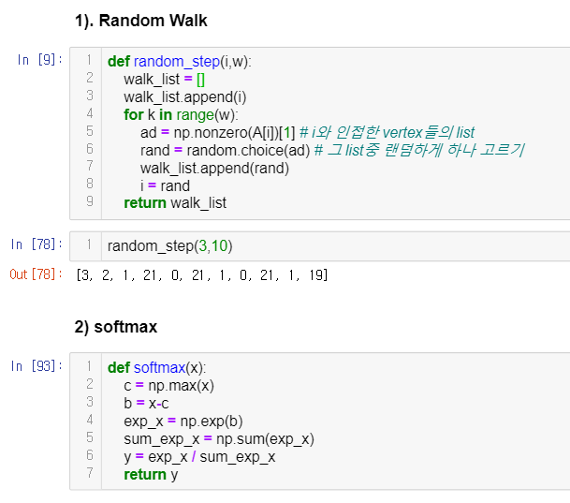
Implementation
2. Define Functions (Random Walk, Softmax, Feed Forward, Back Propagation)
https://medium.com/@jonathan_hui/machine-learning-summary-algorithm-d75c64963800

Slide 23
Implementation
2. Define Functions (Random Walk, Softmax, Feed Forward, Back Propagation)
Row 0 | 0 | 1 | 1 | 0 | 0 | … | 1 | 1
Row 1 | 1 | 0 | 0 | 1 | 0 | … | 1 | 0
… | … |  |  |  |  |  | 1 | …
Row 32 | 1 | 1 | 0 | 0 | 1 | 1 | 0 | 0
Row 33 | 1 | 1 | 1 | 0 | 0 | … | 0 | 0
CC

Slide 24
Implementation
2. Define Functions (Random Walk, Softmax, Feed Forward, Back Propagation)
Row 0 | 0 | 1 | 1 | 0 | 0 | … | 1 | 1
Row 1 | 1 | 0 | 0 | 1 | 0 | … | 1 | 0
… | … |  |  |  |  |  | 1 | …
Row 32 | 1 | 1 | 0 | 0 | 1 | 1 | 0 | 0
Row 33 | 1 | 1 | 1 | 0 | 0 | … | 0 | 0
CC
(input) 1 - 32

Slide 25
Implementation
2. Define Functions (Random Walk, Softmax, Feed Forward, Back Propagation)
Row 0 | 0 | 1 | 1 | 0 | 0 | … | 1 | 1
Row 1 | 1 | 0 | 0 | 1 | 0 | … | 1 | 0
… | … |  |  |  |  |  | 1 | …
Row 32 | 1 | 1 | 0 | 0 | 1 | 1 | 0 | 0
Row 33 | 1 | 1 | 1 | 0 | 0 | … | 0 | 0
CC
Row 0 | 0 | 1 | 1 | 0 | 0 | … | 1 | 1
Row 1 | 1 | 0 | 0 | 1 | 0 | … | 1 | 0
… | … |  |  |  |  |  | 1 | …
Row 32 | 1 | 1 | 0 | 0 | 1 | 1 | 0 | 0
Row 33 | 1 | 1 | 1 | 0 | 0 | … | 0 | 0
(input) 1 - 32 - 0

Slide 26
Implementation
2. Define Functions (Random Walk, Softmax, Feed Forward, Back Propagation)
Row 0 | 0 | 1 | 1 | 0 | 0 | … | 1 | 1
Row 1 | 1 | 0 | 0 | 1 | 0 | … | 1 | 0
… | … |  |  |  |  |  | 1 | …
Row 32 | 1 | 1 | 0 | 0 | 1 | 1 | 0 | 0
Row 33 | 1 | 1 | 1 | 0 | 0 | … | 0 | 0
CC
Row 0 | 0 | 1 | 1 | 0 | 0 | … | 1 | 1
Row 1 | 1 | 0 | 0 | 1 | 0 | … | 1 | 0
… | … |  |  |  |  |  | 1 | …
Row 32 | 1 | 1 | 0 | 0 | 1 | 1 | 0 | 0
Row 33 | 1 | 1 | 1 | 0 | 0 | … | 0 | 0
Row 0 | 0 | 1 | 1 | 0 | 0 | … | 1 | 1
Row 1 | 1 | 0 | 0 | 1 | 0 | … | 1 | 0
… | … |  |  |  |  |  | 1 | …
Row 32 | 1 | 1 | 0 | 0 | 1 | 1 | 0 | 0
Row 33 | 1 | 1 | 1 | 0 | 0 | … | 0 | 0
(input) 1 - 32 - 0 - 2

Slide 27
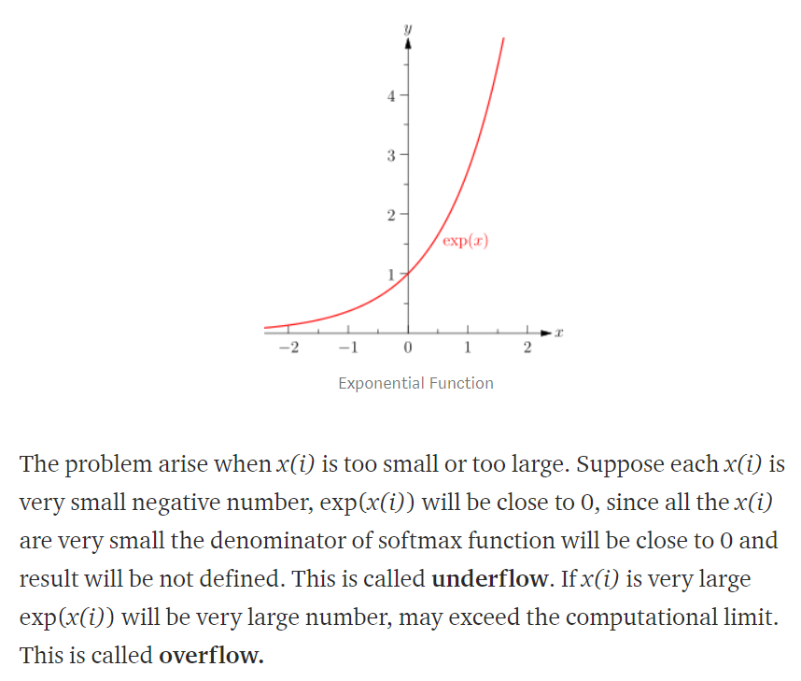
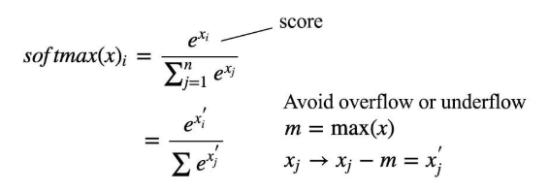
Implementation
2. Define Functions (Random Walk, Softmax, Feed Forward, Back Propagation)
CC
https://medium.com/@jonathan_hui/machine-learning-summary-algorithm-d75c64963800
https://medium.com/@ravish1729/analysis-of-softmax-function-ad058d6a564d

Slide 28
Implementation
2. Define Functions (Random Walk, Softmax, Feed Forward, Back Propagation)
CC
https://medium.com/@jonathan_hui/machine-learning-summary-algorithm-d75c64963800
https://medium.com/@ravish1729/analysis-of-softmax-function-ad058d6a564d

Slide 29
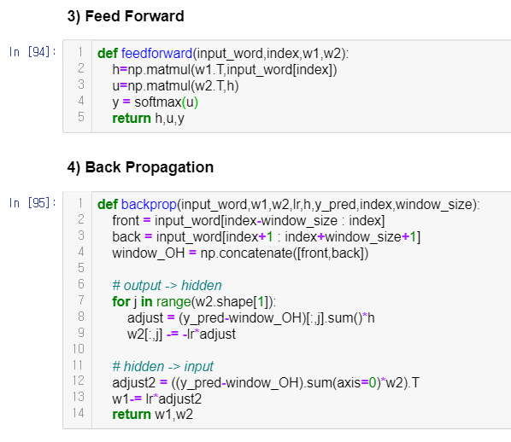
Implementation
2. Define Functions (Random Walk, Softmax, Feed Forward, Back Propagation)

Slide 30


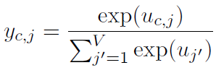
Implementation
2. Define Functions (Random Walk, Softmax, Feed Forward, Back Propagation)
CC

Slide 31
Implementation
2. Define Functions (Random Walk, Softmax, Feed Forward, Back Propagation)
CC
Calculate the hidden layer ( W : input -> hidden weight )
( k : index of input word )

Slide 32
Implementation
2. Define Functions (Random Walk, Softmax, Feed Forward, Back Propagation)
CC
Input of j-th unit on the c-th panel of the output layer ( c : # of Multinomial Distributions )

Slide 33
Implementation
2. Define Functions (Random Walk, Softmax, Feed Forward, Back Propagation)
CC
output of the j-th unit on the c-th panel

Slide 34
Implementation
2. Define Functions (Random Walk, Softmax, Feed Forward, Back Propagation)
CC

Slide 35
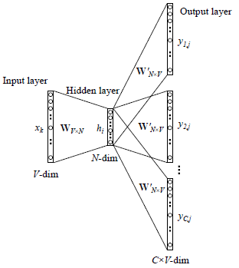
Implementation
2. Define Functions (Random Walk, Softmax, Feed Forward, Back Propagation)
CC
Actual Value of Output Words
CC
predicted
actual

Slide 36
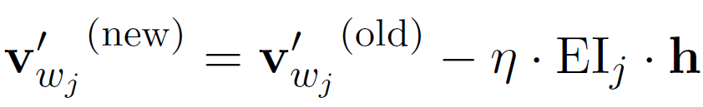
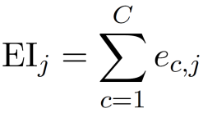

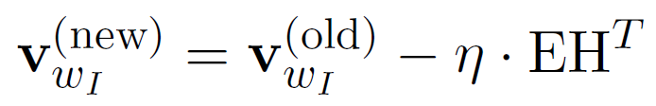
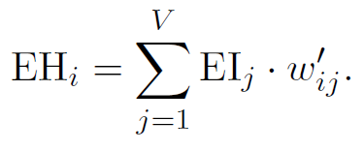
Implementation
2. Define Functions (Random Walk, Softmax, Feed Forward, Back Propagation)
CC
CC

Slide 37
Implementation
2. Define Functions (Random Walk, Softmax, Feed Forward, Back Propagation)
CC
CC

Slide 38
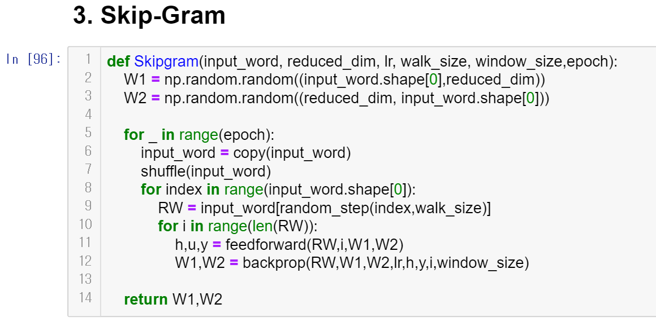
Implementation
3. Skip Gram
[ Input Variables ]
1. input_word : Matrix of Input Words ( 34 x 34 Identity Matrix )
2. reduced_dim : Dimension of the embedded vector
3. lr : Learning Rate
4. walk_size :
Walk length in random walk
5. window_size :
(one-sided) Size of the window from the index
6. epoch :
Walks per vertex

Slide 39
Implementation
3. Skip Gram
[ Process ]
1) Initialize weight ( uniform distribution ) ( W1 : input – hidden Weight )
( W2 : hidden – output Weight )
2) Shuffle the words
3) Implement a Random Walk
4) Feed Forward ( with the vertices selected by RW )
5) Back Propagation
6) Return Weights

Slide 40
3. Result
Visualization of Network

Slide 41
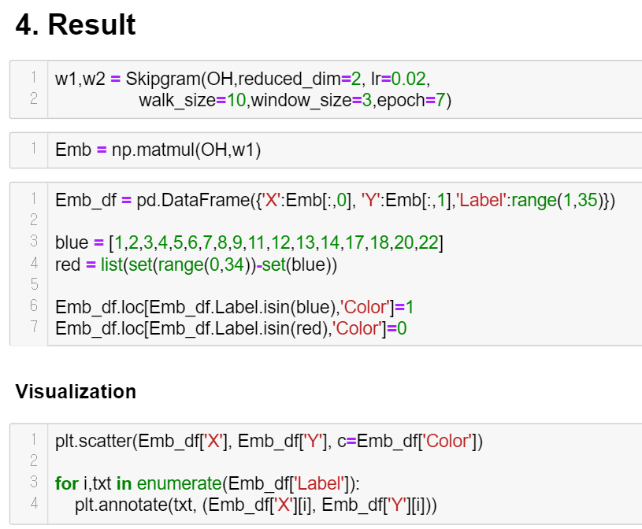
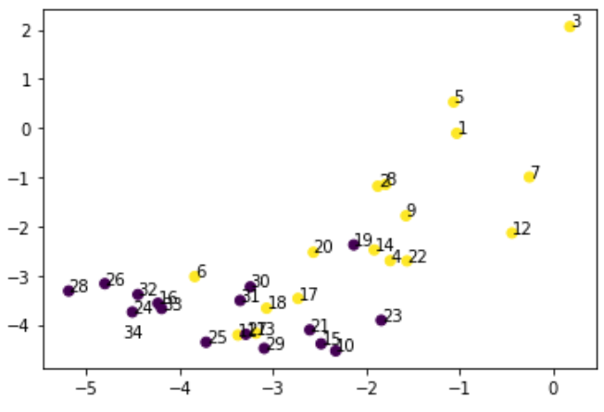
Result

Slide 42
Reference
[1] Bryan Perozzi, Rami AI-Rfou, Steven Skiena : Deepwalk : Online Learning
of Social Representations
[2] Xin Rong : word2vec Parameter Learning Explained

Slide 43
Thank You!!

